Slide 1
Data Structures Augmentation
Choosing a Data Structure
SoftUni Team
Technical Trainers
Software University
http://softuni.bg

Slide 2
Table of Contents
Classical Collection Data Structures – Summary
Linear Data Structures
Balanced Binary Search Trees
Hash Tables
Choosing a Collection Data Structure
Data Structures Augmentation

Slide 3
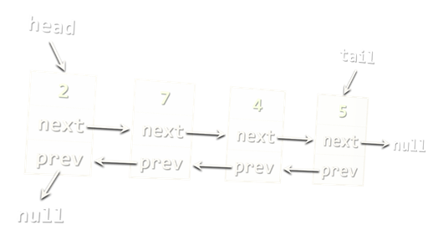
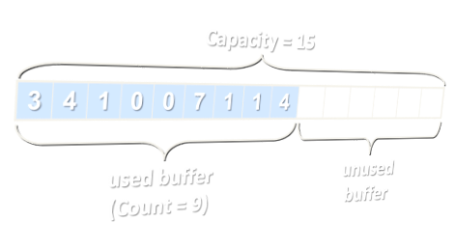
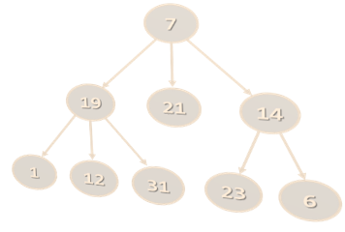
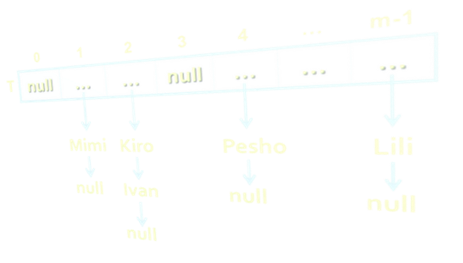
Choosing the Right DS
Lists vs. Hash Tables vs. Balanced Trees

Slide 4
Choosing a Collection - Array
Array (T[])
Use when fixed number of elements need processing by index
No resize → for fixed number of elements only
Add / delete needs creating a new array + move O(n) elements
Compact and lightweight
Data Structure | Add | Find | Delete | Get-by-index
Static array: T[] | O(n) | O(n) | O(n) | O(1)

Slide 5
Choosing a Collection – Array Based List
Resizable array-based list (List<T>)
Use when elements should be added fast and processed by index
Add (append to the end) has O(1) amortized complexity
The most-often used collection in programming
Data Structure | Add | Find | Delete | Get-by-index
Auto-resizable array-based list: List<T> | O(1) | O(n) | O(n) | O(1)

Slide 6
Choosing a Collection – Linked List
Doubly-linked list (LinkedList<T>)
Use when elements should be added at the both sides of the list
Use when you need to remove by a node reference
Otherwise use resizable array-based list (List<T>)
Data Structure | Add | Find | Delete | Get-by-index
Double-linked list: LinkedList<T> | O(1) | O(n) | O(n) | O(n)

Slide 7
Choosing a Collection – Stack
Stack (Stack<T>)
Use to implement LIFO (last-in-first-out) behavior
List<T> could also work well
Data Structure | Add | Find | Delete | Get-by-index
Stack: Stack<T> | O(1) | - | O(1) | -

Slide 8
Choosing a Collection – Queue
Queue (Queue<T>)
Use to implement FIFO (first-in-first-out) behavior
LinkedList<T> could also work well
Data Structure | Add | Find | Delete | Get-by-index
Queue: Queue<T> | O(1) | - | O(1) | -

Slide 9
Choosing a Collection – Map
Hash-table-based map (Map<K, V>)
Fast add key-value pairs + fast search by key – O(1)
Keys have no particular order
Keys should implement hashCode(…) and equals(…)
Data Structure | Add | Find | Delete | Get-by-index
Hash-table: Map<K, V> | O(1) | O(1) | O(1) | -

Slide 10
Choosing a Collection – Tree Map
Balanced tree-based map (TreeMap<K, V>)
Elements are ordered by key
Fast add key-value pairs + fast search by key + fast sub-range
Keys should be Comparable<K>
Balanced trees → slower than hash-tables: O(log n) vs. O(1)
Data Structure | Add | Find | Delete | Get-by-index
Balanced tree-based dictionary: TreeMap<K, V> | O(log n) | O(log n) | O(log n) | -

Slide 11
Choosing a Collection – Multi Map
Hash-table-based multi-dictionary (MultiMap<K, V>)
Fast add key-value + fast search by key + multiple values by key
Add by existing key appends a new value for the same key
Keys have no particular order
Data Structure | Add | Find | Delete | Get-by-index
Hash-table-based multi-dictionary: MultiMap<K, V> | O(1) | O(1) | O(1) | -

Slide 12
Choosing a Collection – Tree Multi Map
Tree-based multi-dictionary (TreeMultiMap<K, V>)
Keys are ordered by key
Fast add key-value + fast search by key + fast sub-range
Add by existing key appends a new value for the same key
Data Structure | Add | Find | Delete | Get-by-index
Tree-based multi-dictionary: TreeMultiMap<K, V> | O(log n) | O(log n) | O(log n) | -

Slide 13
Choosing a Collection – Hash Set
Hash-table-based set (HashSet<T>)
Unique values + fast add + fast contains
Elements have no particular order
Elements should implement hashCode(…) and equals(…)
Data Structure | Add | Find | Delete | Get-by-index
Hash-table-based set: HashSet<T> | O(1) | O(1) | O(1) | -

Slide 14
Choosing a Collection – Tree Set
Balanced tree-based set (TreeSet<T>)
Unique values + sorted order
Fast add + fast contains + fast sub-range
Elements should be Comparable<T>
Data Structure | Add | Find | Delete | Get-by-index
Balanced tree-based set: TreeSet<T> | O(log n) | O(log n) | O(log n) | -

Slide 15
Choosing a Collection – Hash Bag
Hash-table-based bag (Bag<T>)
Bags allow duplicates
Fast add + fast find + fast contains
Elements have no particular order
Data Structure | Add | Find | Delete | Get-by-index
Hash-table-based bag: Bag<T> | O(1) | O(1) | O(1) | -

Slide 16
Choosing a Collection – Tree Bag
Balanced tree-based bag (TreeBag<T>)
Allow duplicates, sorted order
Fast add + fast find + fast contains
Access by sorted index + extract sub-range
Data Structure | Add | Find | Delete | Get-by-index
Balanced tree-based bag: TreeBag<T> | O(log n) | O(log n) | O(log n) | -

Slide 17
Choosing a Collection – Special DS
Priority Queue (Heap) – fast max/min element
Rope – fast add/remove by index
Prefix tree (Trie) – fast prefix search
Suffix tree – fast suffix search
Interval tree – fast interval search
K-d trees, Quad trees – fast geometric distance search

Slide 18
Data Structure Efficiency – Comparison
Data Structure | Add | Find | Delete | Get-by-index
Static array: T[] | O(n) | O(n) | O(n) | O(1)
Double-linked list: LinkedList<T> | O(1) | O(n) | O(n) | O(n)
Auto-resizable array-based list: List<T> | O(1) | O(n) | O(n) | O(1)
Stack: Stack<T> | O(1) | - | O(1) | -
Queue: Queue<T> | O(1) | - | O(1) | -

Slide 19
Data Structure Efficiency – Comparison (2)
Data Structure | Add | Find | Delete | Get-by-index
Hash-table: Map<K, V> | O(1) | O(1) | O(1) | -
Balanced tree-based dictionary: TreeMap<K, V> | O(log n) | O(log n) | O(log n) | -
Hash-table-based set: HashSet<T> | O(1) | O(1) | O(1) | -
Balanced tree-based set: TreeSet<T> | O(log n) | O(log n) | O(log n) | -

Slide 20
Data Structure Efficiency – Comparison (3)
Data Structure | Add | Find | Delete | Get-by-index
Hash-table-based multi-dictionary: MultiMap<K, V> | O(1) | O(1) | O(1) | -
Tree-based multi-dictionary: TreeMap<K, V> | O(log n) | O(log n) | O(log n) | -
Hash-table-based bag: Bag<T> | O(1) | O(1) | O(1) | -
Balanced tree-based bag: TreeBag<T> | O(log n) | O(log n) | O(log n) | -

Slide 21
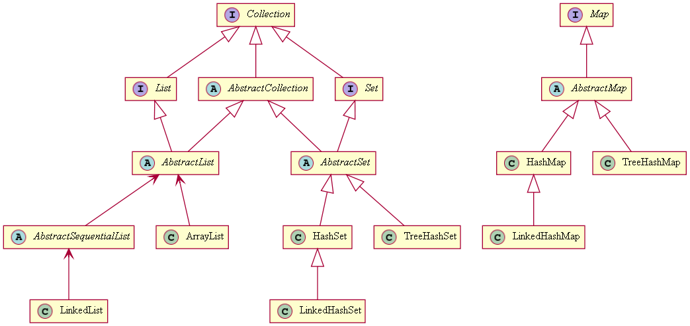
Java – Collections/Guava APIs
All commonly used collections
java.util.Collections
com.google.common.collect

Slide 22

Data Structures Augmentation

Slide 23
Combining Data Structures
Many scenarios → combine several DS
No ideal DS → choose between space and time
For example, we can combine:
A hash-table for fast search by key₁ (e.g. name)
A hash-table for fast search by {key₂ + key₃} (e.g. name + town)
A balanced search tree for fast extract-range(start_key … end_key)
A rope for fast access-by-index
A balanced search tree for fast access-by-sorted-index

Slide 24
Problem: Collection of People
Design a data structure that efficiently implements:
Operation | Return Type
add(email, name, age, town) | boolean – unique email
find(email) | Person or null
delete(email) | boolean
findAll(email_domain) | Iterable<P> – sorted by email
findAll(name, town) | Iterable<P> – sorted by email
findAll(start_age, end_age) | Iterable<P> – sorted by age, email
findAll(start_age, end_age, town) | Iterable<P> – sorted by age, email

Slide 25
List Based Solution
List based solution – single list for all operations
Easy to implement
Easy to achieve correct behavior
Useful for creating unit tests
0 | 1 | 2 | … | n-1
Mimi | Jana | Acho | … | Lili

Slide 26
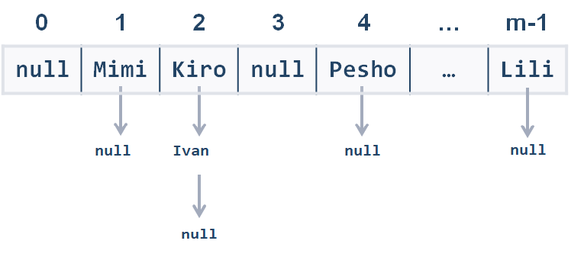
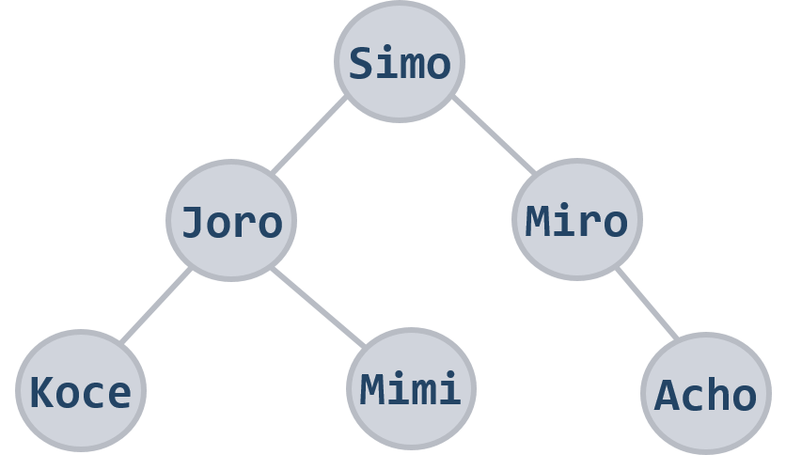
Solution: Add Person
boolean add(email, name, age, town)
Create a Person object to hold { email + name + age + town }
Add the new person to all underlying data structures
Add

Slide 27
Solution: Find by Email
Person find(email)
Use a hash-table to map { email → person }
Complexity – O(1)

Slide 28
Solution: Delete
bool delete(email)
Find the person by email in the underlying hash-table
Delete the person from all underlying data structures
Complexity – O(log n)
Delete

Slide 29
Solution: Find by Domain
Iterator<Person> findAll(email_domain)
Use a hash-table to map {email_domain → SortedSet<Person>}
Get email_domain by the email when adding persons
Complexity – O(1)
abv.bg
gmail.com
hotmail.com

Slide 30
Solution: Find by Name + Town
Iterator<Person> findAll(name, town)
Combine the keys {name + town} into a single string name_town
Use a hash-table to map {name_town → SortedSet<Person>}
Complexity – O(1)
Pesho VT
Mimi SF
Jana PLD

Slide 31
Problem: Collection of People
Iterator<Person> findAll(start_age, end_age)
Use a balanced search tree to keep all persons ordered by age:
TreeMap<Integer, TreeSet<Person>>
Use the range(start_age, end_age) operation in the tree
Complexity – O(log n)
17
9
19
12
6

Slide 32
Problem: Collection of People
Iterator<Person> findAll(start_age, end_age, town)
Use a hash-table to map {town → people by ages}
People by ages can be stored as balanced search tree:
TreeMap<Integer, SortedSet<Person>>
17
VT
SF
PLD
9
19
12
6
17
9
17
19
9
19
12
6
12
6

Slide 33

Summary
Different data structures have different efficiency for their operations
List-based collections provide fast append and access-by-index, but slow find and delete
The fastest add / find / delete structure is the hash table – O(1) for all operations
Balanced trees are ordered – O(log n) for add / find / delete + range(start, end)
Data structures Augmentation is often essential
E.g. combine multiple hash-tables to find by different keys

Slide 35












SoftUni Diamond Partners

Slide 36




SoftUni Organizational Partners

Slide 37

License
This course (slides, examples, demos, videos, homework, etc.) is licensed under the "Creative Commons Attribution-NonCommercial-ShareAlike 4.0 International" license

Slide 38





Trainings @ Software University (SoftUni)
Software University – High-Quality Education, Profession and Job for Software Developers
softuni.bg
Software University Foundation
http://softuni.foundation
Software University @ Facebook
facebook.com/SoftwareUniversity
Software University Forums
forum.softuni.bg

